Slide 1
AXIOM FORGE
PRINCIPLES TURNED INTO PRACTICE
ROUTINES THAT TURN INTENT INTO IDENTITY
// MIT Sandbox Innovation Fund
January 2026
Working Prototype Pitch Deck
Javier Serrano

Slide 2
// Context
ROUTINES ARE THE NEW OBSESSION…
+70B
views on routine videos (just on TikTok)
INFLUENCERS ARE PROVING DEMAND
Andrew Huberman
7.3M subs - Neuroscience-backed routines
#skincareroutine 37B+ views
#morningroutine 27B+ views
#nightroutine 11B+ views
Ashton Hall
18M+ followers - High-energy fitness routines
750M+ views on a single morning routine video
Massive Engagement vs Other Content
Ali Abdaal
6.5M subs - Productivity systems & habit stacking
Routine-based
6-10x
General Wellness
1x
James Clear
25M+ Atomic Habits sold - Created demand for systems
Massive audience wanting to DO routines, not just WATCH them
Source: Broadcasting your breakfast: why TikTokers obsess over morning routines - The Guardian; Why We're Obsessed with Other People's Morning Routines – Time Magazine; Meet Ashton Hall: The Man Behind the Viral Morning Routine – BBN Times
2

Slide 3
// Problem
…BUT FEW PEOPLE ACTUALLY STAY CONSISTENT
66%
of Gen Z adopt digital wellness tools to adopt healthier lifestyles... Yet behavior rarely sticks!
WHY PEOPLE FAIL?
No Bridge from Content to Action
Videos inspire but offer no execution tool
+90%
of people quit/fail when trying to form new habits
Blank Slate Paralysis
Users don’t know what habits to track or how many
Streak Anxiety
One miss = total abandonment
~4%
Avg. Day 30 retention rate in health & fitness apps
No Actionable Insights
Available apps tell users WHAT they did,
not WHY they succeeded or failed
// Mission
Help people turn routine inspiration into routine execution, so they can become their best selves and truly reach their goals
Source: The $2 trillion global wellness market gets a millennial and Gen Z glow-up - McKinsey & Company; Retention Rates for Mobile Apps by Industry - Plotline; Only 10% of people who try to create a habit achieve their goal - Summa Magazine
3

Slide 4
// Solution
AXIOM FORGE: A HABIT TRACKING APP BUILT ON SCIENCE, REINFORCED BY INSIGHT & MINDSET PILLS
SCIENCE-BACKED
SMART ROUTINES
DEEP BEHAVIORAL INSIGHTS
TOP PERFORMERS’ MINDSET PILLS
Patterns that explain success and failure, generated from user data
Evidence-based templates that remove blank slate paralysis
Daily wisdom that reinforces identity and goal focus
Morning + evening routines¹ ready from day one
Structured and specific for certain goals (incl. sleep, fitness, focus)
Designed for real schedules, not perfection
Correlation, weekday patterns, and trend signals
Sequence analysis for "what works together"
Anomalies detection, strength scores and alerts
Motivational and thought-provoking daily quotes from thought leaders and top performers
Reflection journaling
Rating & archive history
1. Each routine is composed by 5 morning habits and 5 evening habits, with directly accessible scientific basis and sources
4

Slide 5
// Market
AXIOM FORGE TAPS INTO THE RAPIDLY- GROWING HABIT TRACKING APP MARKET
GLOBAL HABIT TRACKING APP MARKET (USD B)
KEY MARKET GROWTH DRIVERS
50.2
Rising consumer emphasis on self-improvement and productivity enhancement: 68% of smartphone users engage with at least one productivity or wellness app
Market projected to triple within the next 10 years
CAGR 14.4%
CAGR 14.3%
Higher Willingness To Pay: Premium subscriptions account for 36% of overall habit tracking app downloads
17.1
14.9
13.1
Complementary to surge of wearables through integration: Wearable integration improves user retention by 39%
2025
2026
2027
2028
2029
2030
2031
2032
2033
2034
2035
Source: Global Habit Tracking App Market Size - Global Growth Insights
5

Slide 6
// Competition
AXIOM FORGE IS POSITIONED AS THE ONLY APP COMBINING SCIENCE, IN-DEPTH INSIGHTS & JOURNAL
HABIT TRACKER APP | SCIENCE-BACKED TEMPLATES (ACTIONABILITY) | BEHAVIORAL INSIGHTS (UNDERSTANDING) | MINDSET/JOURNAL (MOMENTUM) | CROSS-PLATFORM
Axiom Forge | Evidence-Based | Full Personalized Analysis | Motivational Sentences + Journal | PWA (planning to expand to iOS)
Streaks | - | - | - | iOS Only
Habitica | Generic | Basic Stats | - | Yes
Loop | - | Decent Analysis | - | Android
Habitify | - | Only Mood Tracking | Notes per habit | Yes
+50% users discontinue app usage due to lack of personalization or overwhelming interface design 44% switch apps due to motivation drop-off after missing habit streaks
Axiom Forge is designed to maximize long-term user retention, built around three pillars —Actionability, Understanding and Momentum— and a strict No-BS philosophy reflected across its feature set, visual language, and user interface
Source: Habit Tracker Apps Websites, App Store User’s Reviews, Global Habit Tracking App Market Size - Global Growth Insights
6

Slide 7
// Prototype
AXIOM FORGE IS CURRENTLY A FULLY-FUNCTIONAL PROTOTYPE, VALIDATED BY EARLY USERS
CURRENT STATE
VALIDATION
PWA¹ live with Firebase auth + cloud sync
Daily check-ins for 4 customizable pre-populated goal-based routines
Dashboard with completion rates trends, streaks, strength scores, calendar heatmap and weekly patterns
Smart Insights engine (incl. correlation, trends, anomalies, sequences)
Mindset pills showing quotes from top performers, complemented by rating & personal reflections journal
Validated by first early adopters
Qualitative feedback confirms need for clarity, desire for deeper insights, and love for mindset-boosting quotes
Next Validation Goal
Run 40-60 user interviews + beta cohort to confirm retention and pricing
1. PWA: Progressive Web App: Web application that behaves much like a native mobile app (e.g., App Store app), offering features such as offline and low-connectivity support, fast loading, and push notifications. PWAs are also responsive and secure
7

Slide 8
// Business Model
FREE CORE FEATURES COUPLED WITH PREMIUM PLANS AND BRANDS/INFLUENCERS CONTENT
NON-EXHAUSTIVE
PENDING TO BE TESTED WITH USERS & POTENTIAL PARTNERS
FREEMIUM CORE (FREE FOREVER)
Daily tracking and visualization dashboard, mindset pills & journaling, science-based routines, and basic personalized analytics (incl. weekly patterns, strength alerts)
INSIGHTS PRO
AI COACH LAYER
CONTENT PACKS
SPONSORED/GROUP CHALLENGES
Advanced behavioral analytics (incl. correlations, anomalies, sequences)
AI summaries based on real data & personalized habit recommendations
Premium routine templates (e.g., skincare, study focus) from influencers and productivity experts
Brand-sponsored challenges with real rewards (e.g., discounts on products)
$2.99/mo or $25/year
Axiom Forge’s engine
$4.99/mo or $39/year
LLM-generated
$2.99/pack
Influencers partnerships
FREE
Brands pay $0.5-2/user
Currently available
To be developed
8

Slide 9
// Go-To-Market
MIT-TO-MARKET STRATEGY: VALIDATE ON CAMPUS, THEN EXPAND WITH PROVEN MODEL
PHASE 1: MIT LAUNCH + FAMILY & FRIENDS
PHASE 2: BOSTON COLLEGES EXPANSION
PHASE 3: SOCIAL MEDIA + INFLUENCERS
Weeks 1-3
Weeks 4-5
Weeks 6+
Emails/messages to MIT communities (e.g., entrepreneurship) and to personal network
Student group demos
Referral program with incentives
Boston universities (e.g., Harvard, BU, Northeastern)
Student ambassador program
Posts on college subreddits
Reddit productivity channels
Content marketing (e.g., 2-3 TikToks/YouTube shorts per week)
Reach out to 20 routine influencers
Target: 25-30 users
Target: 25-30 users
Target: 100+ users
9

Slide 10
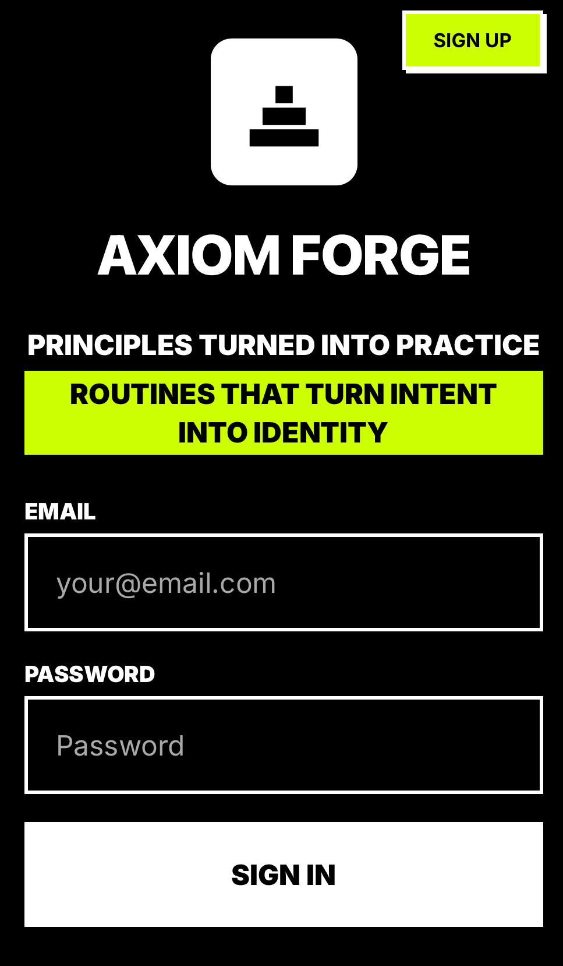
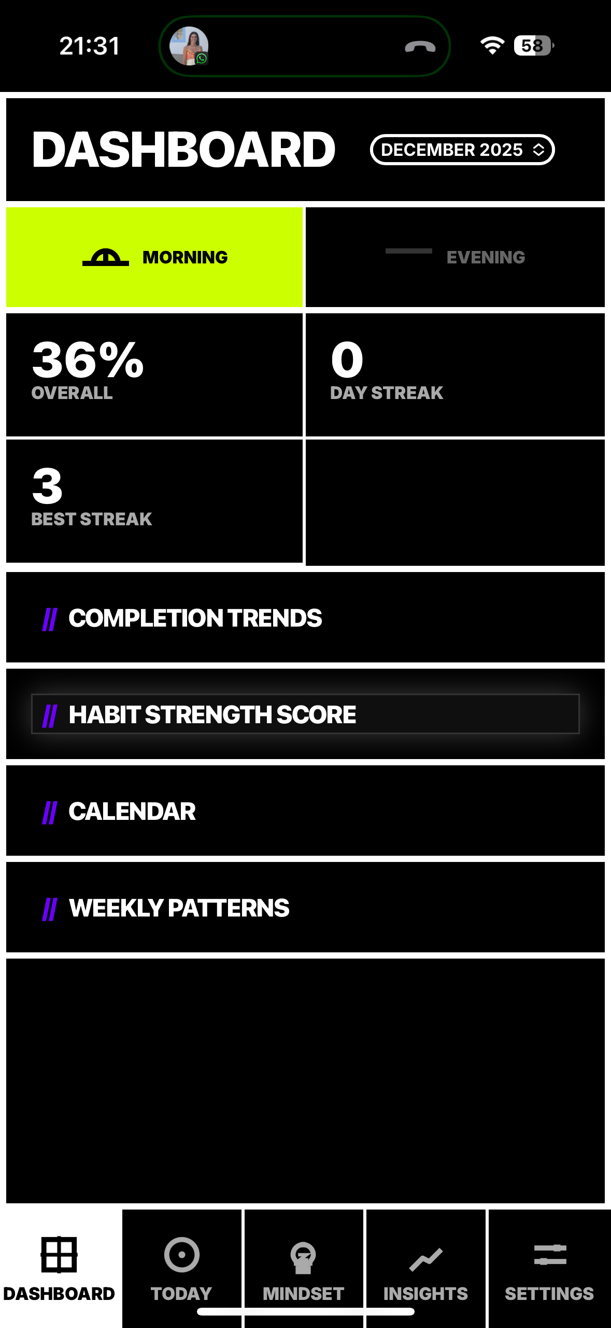
// Prototype Demo
WATCH AXIOM FORGE IN ACTION
ONBOARDING
APP FEATURES¹
TRY IT YOURSELF
No download required - works in your desktop and mobile browsers
Click Play Button to Watch
Click Play Button to Watch
LAUNCH AXIOM FORGE
Length: ~2 mins
Length: ~3 mins
1. Includes Freemium Core & Insights Pro features
10

Slide 11
// Roadmap
90-DAY SPRINT TO GO FROM VALIDATION TO APP STORE LAUNCH
01
02
03
FURTHER VALIDATE
POLISH
LAUNCH
Run 40-60 user interviews
Build beta cohort with retention tracking
Test pricing & monetization paths
Refine features & UI/UX
Enhance performance + onboarding experience
Prepare brand + marketing assets
Prepare App Store packaging and legal entity
Public release + social media outreach
Analyze post-launch metrics and iterate
Q2 2026
APP STORE LAUNCH TARGET
11

Slide 12
// Funding Request
$4,800 REQUESTED TO SUPPORT ROADMAP EXECUTION
USER RESEARCH
$1100
Run 40-60 customer discovery interviews with beta testers, including focus group sessions and small participation incentives
CONTRACTORS
$900
Hire UI/UX designer or MIT intern to polish user experience and app performance, help develop premium features and create professional marketing assets for App Store launch
TRAVEL & CONFERENCES
$800
Attend wellness/productivity conferences to conduct customer research and connect with potential partners and routine influencers
SOFTWARE & TOOLS
$700
Subscribe to analytics tools (e.g., Amplitude), design software (e.g., Figma), and cover Firebase scaling costs during beta
LEGAL & COMPLIANCE
$700
File for company incorporation, register as a legal entity, and secure registered agent services
MARKETING & LAUNCH
$600
Launch targeted social media campaigns on Instagram/TikTok and create promotional video content for App Store listing
12

Slide 13






// Team
WHO’S BEHIND AXIOM FORGE
SOLO FOUNDER
Engineer and Student Athlete With Background in Digital & Healthcare Management Consulting, AI-first Startups and M&A at Digital Health Corporate
JAVIER SERRANO
MIT Sloan MBA Candidate ‘27
13

Slide 14

// End of Pitch Deck
THANK YOU FOR READING THIS FAR!
// SPOILER ALERT: YOUR DAY 1 MINDSET PILL
MINDSET
// DAILY MINDSET PILL FROM TOP PERFORMERS
"
HERE'S THE BIG CHALLENGE OF LIFE. YOU CAN HAVE MORE THAN YOU'VE GOT BECAUSE YOU CAN BECOME MORE THAN YOU ARE. AND OF COURSE THE OTHER SIDE OF THE COIN READS, UNLESS YOU CHANGE HOW YOU ARE, YOU'LL ALWAYS HAVE WHAT YOU GOT.
AXIOM FORGE is ready to use. Join the closed beta to unlock the full system
TRY THE PROTOTYPE
"
AND OF COURSE THE OTHER SIDE OF THE COIN READS, UNLESS YOU CHANGE HOW YOU ARE, YOU'LL ALWAYS HAVE WHAT YOU GOT.
JR
JIM ROHN
https://axiomforgeapp.com/
ENTREPRENEUR & SPEAKER
14

Slide 15
AXIOM FORGE
PRINCIPLES TURNED INTO PRACTICE
ROUTINES THAT TURN INTENT INTO IDENTITY

